Slide 1

Final Review – J Component
SWE2011 BIG DATA ANALYTICS
FALL 2023-24
Diabetes data analysis and prediction
Sridhar S 21MIS0140
kaushik S 21MIS0362
Tharun S 21MIS0408

Slide 2
ABSTRACT
Diabetes is a serious chronic disease affecting millions of people worldwide. It is a metabolic condition characterized by high blood sugar levels. Untreated diabetes can lead to severe complications, including heart disease, stroke, kidney damage, blindness, and limb amputation. Early prevention and management of diabetes are crucial for reducing the risk of complications. Machine learning can be a powerful tool for predicting an individual's risk of diabetes. This project aims to explore various datasets related to diabetes and develop a model to predict diabetes in an individuals using a dataset of patients with and without diabetes. XGboost machine learning algorithm has Accuracy of 97.105% and used to evaluate and accurately predict diabetes in new patients.

Slide 3
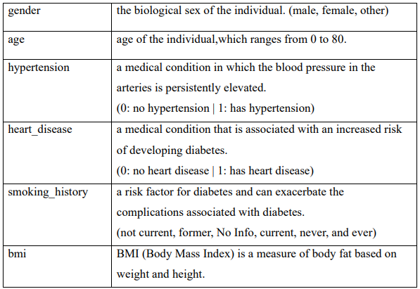
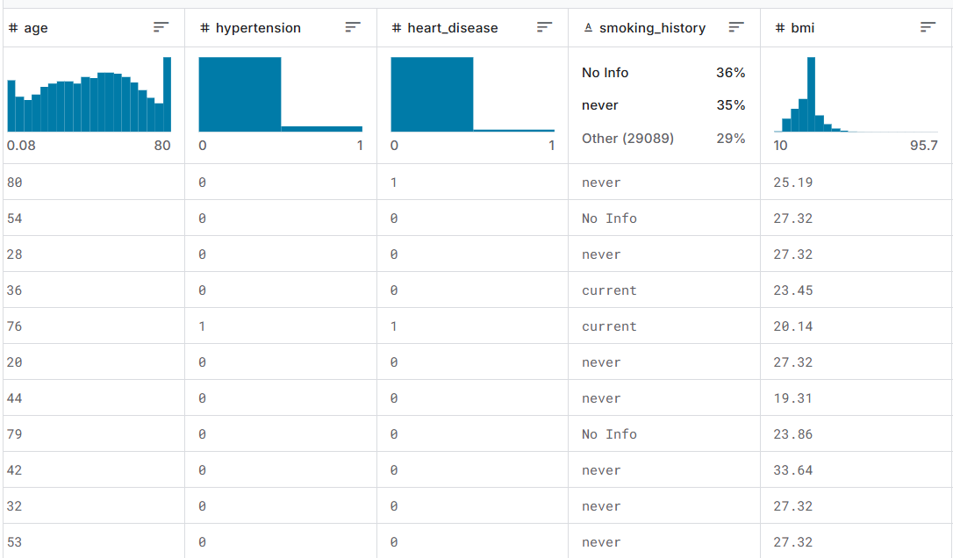
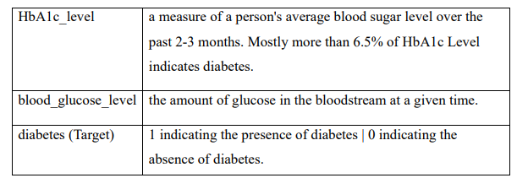
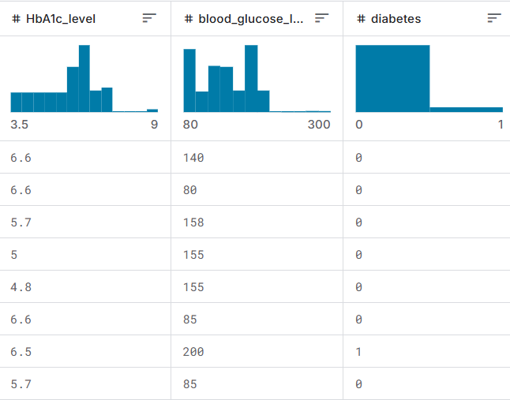
DATASET
The diabetes_prediction_dataset.csv file contains medical and demographic data of patients along with their diabetes status, whether positive or negative. It consists of various features such as age, gender, body mass index (BMI), hypertension, heart disease, smoking history, HbA1c level, and blood glucose level. The Dataset can be utilized for constructing machine learning models that can predict the likelihood of diabetes in patients based on their medical history and demographic details.

Slide 4
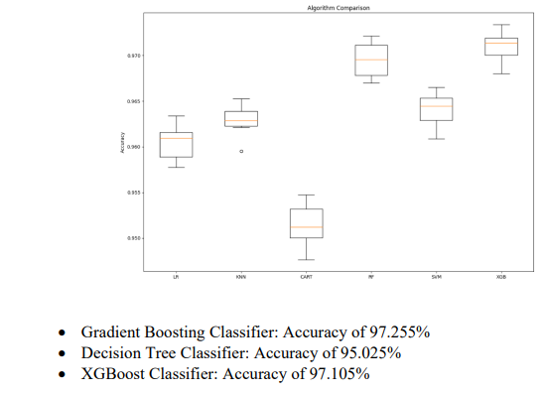
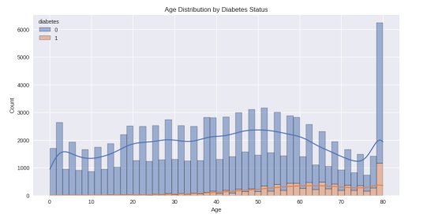
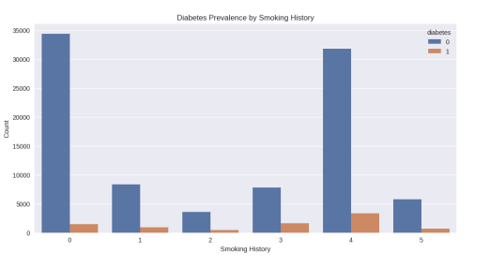
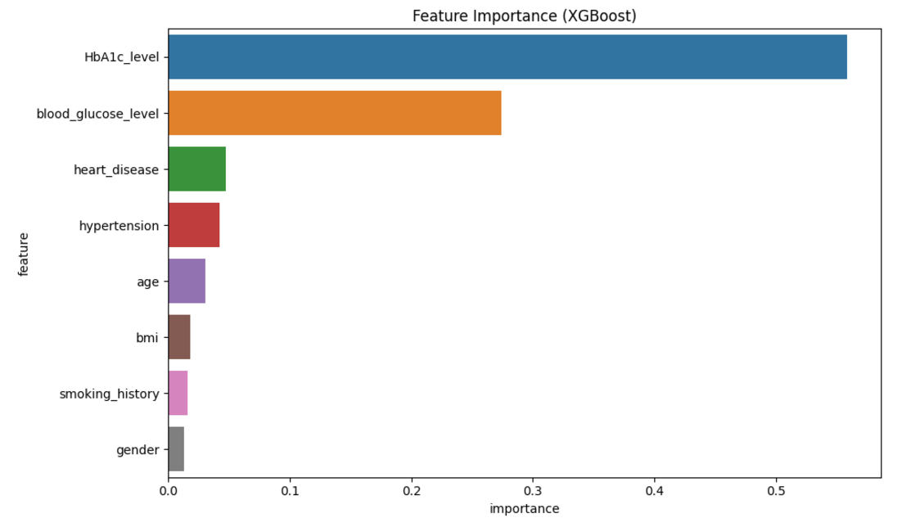
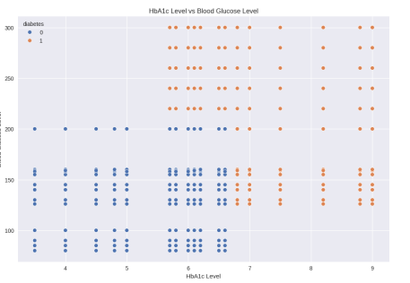
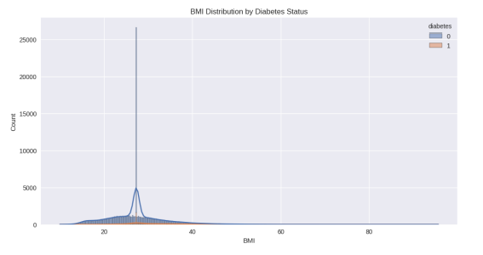
GRAPHS / OUTPUTS

Slide 5
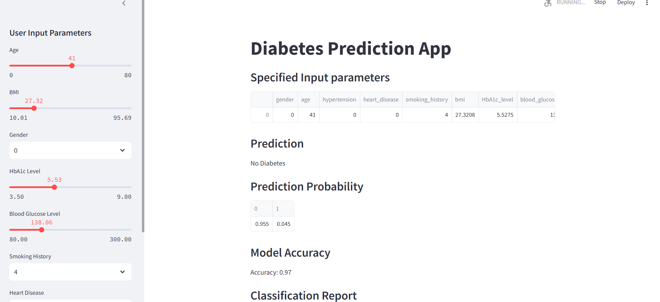
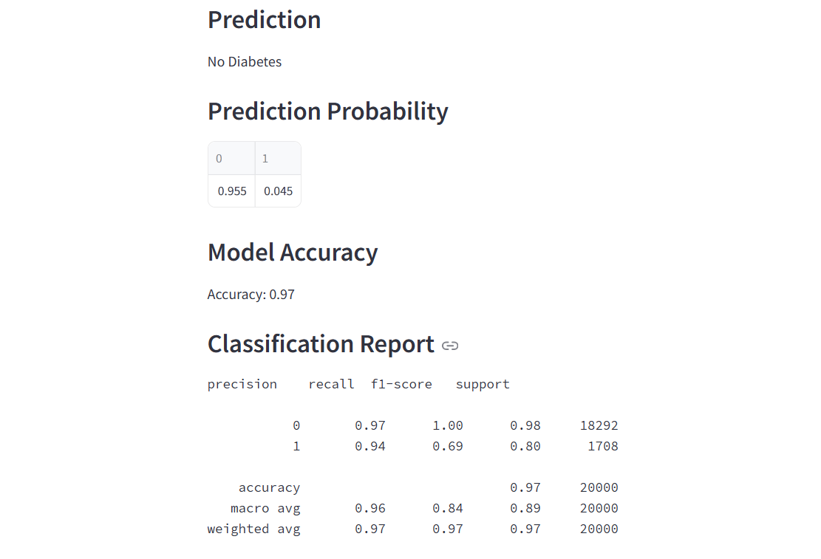

Slide 6
OBSERVATION / RECOMMENDATION
1. Hyperparameter Tuning: Fine-tune model parameters for improved performance.
2. Feature Importance Analysis: Investigate key features to gain medical insights.
3. External Validation: Validate the model on different datasets for generalizability.
4. Clinical Deployment: Explore using the model in clinical settings to aid diabetes management.

Slide 7



